Slide 1
Digital Onboarding:
Testbenching
Silicats

Slide 2
Understanding a design
The most important thing - UNDERSTANDING THE SPECIFICATION!!!!
Must be able to find bugs that the original developer couldn’t find
There could be specifications bugs and there could be implementation bugs
  Latency might be assumed to be something in the spec but not possible in the actual design (specification bug
  Or, part of the pipeline corrupts downstream data (implementation bug)
Things to think about
Simultaneous events
Complicated logic (intentional or not)
Corner cases - corruption and combinational logic
Operating modes / assumptions
Draw pictures! Whiteboard it! FSM it!

Slide 3
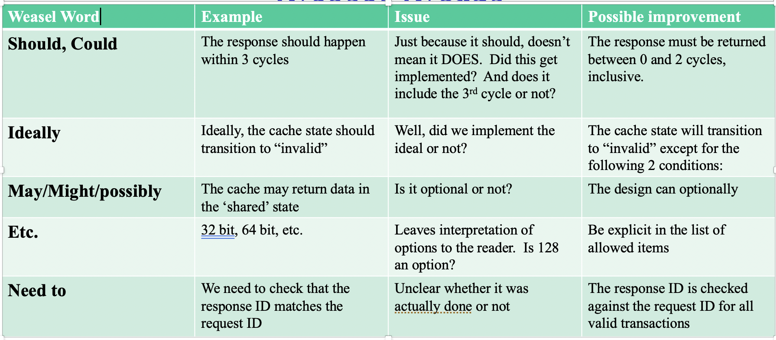

Slide 4
Understanding a design
Other things to consider
Defeatures - Being able to toggle different features on and off in order to better support respins
  Must verify multiple modes, consider all possible cases
Consider power and clocking
Livelock - two units invalidating each other, making transactions invalid and forcing them to continuously retry
Deadlock - two units waiting for a signal from each other

Slide 5
Testbenching - Combinatorial
Going back to an ALU example, here’s a 16-bit unsigned ALU with 5 out of 8 opcodes:
`timescale 1ns/10ps // make sure this is at the top of every .sv module file; controls the timescale used (1ns) & the precision level (10ps)
module ALU(a, b, opcode, out, carry); // module for the ALU; includes the variables in parenthesis to allow for external inputs
input logic [15:0] a;
input logic [15:0] b;
input logic [2:0] opcode;
output logic [15:0] out;
output logic carry;
logic [16:0] tempOut;
// assign sets output variables as constant values that are then changed separately
// think of it as a phone screen: something is always shown, but what the thing shown is depends on internal execution
assign out = tempOut[15:0];
assign carry = tempOut[16];
always_comb begin // used to set logic variables
case(opcode)
3’b000: tempOut = a + b;
3’b001: tempOut = a - b;
3’b010: tempOut = b - a;
3’b011: tempOut = a | b; // a OR b
3’b100: tempOut = a ^ b; // a XOR b
default: tempOut = 17’b0; // sets output to zero for non-supported opcodes
endcase
end
endmodule

Slide 6
Testbenching - Combinatorial
An example testbench for this ALU would then look like this:
`timescale 1ns/10ps
module ALU_test; // test module that contains the variables used as inputs into the design
logic [15:0] a, b, opcode, out;
logic carry;
ALU testbench(.a(a), .b(b), .opcode(opcode), .out(out), .carry(carry)); //explicit instantiation of prior ALU module
initial // keyword used to mark the setup of tests
begin
a = 16'd9000;
b = 16'd9001;
opcode = 3'b000; // 000 test
#10 // inserts a 10-nanosecond delay between tests; critical for result readability & (in sequential logic) functionality
opcode = 3'b001; // 001 test
#10
opcode = 3'b010; // 010 test
#10
opcode = 3'b011; // 011 test
#10
opcode = 3'b100; // 100 test
#10
opcode = 3’b111; // unsupported opcode test
#10
$finish; // make sure to include this to signal end of test
end
endmodule

Slide 7
Testbenching - Sequential
Moving on to sequential logic, let’s use a 4-bit adjustable counter as an example:
`timescale 1ns/10ps
module counter(clk, rstb, offset, counterOut);
input logic clk, rstb;
input logic offset; // allows the counter to increase by 2 instead of 1 each clock cycle
output logic [3:0] counterOut;
always_ff @(posedge clk or negedge rstb) begin
if (!rstb)
counterOut <= 4’b0; // resets the counter to zero
else
counterOut <= counterOut + offset + 4’b1; // adds 1 or 2 to the counter, wrapping around automatically due to overflow
end
endmodule

Slide 8
Testbenching - Sequential
An example testbench for this counter would then look like this:
`timescale 1ns/10ps
module counter_test;
logic clk, rstb, offset;
logic [3:0] counterOut;
counter Testbench(.clk(clk), .rstb(rstb), .offset(offset), .counterOut(counterOut));
always begin // create the clock signal used for the tests
#1 clk = ~clk; // clk switches from 1 to 0 every 1 ns
end
integer i; // integers can be used in testbenches to setup more complex tests, including for loops
initial begin
clk = 0;
rstb = 0;
#2
rstb = 1; // ends test of reset functionality after 1 clock cycle
for (i = 1; i <= 20; i = i + 1) begin // runs enough tests to test overflow reset
@(posedge clk); // tells the for loop to wait until right after a rising edge before sampling data, inserting a 1-cycle gap
#0.1; // basic delay to satisfy timing constraints; these should be inserted & adjusted in line with timing from synthesis
if (i == 3 || i == 11) // tests both +1 offset and no offset
offset = 1;
else
offset = 0;
end
$finish;
end
endmodule

Slide 9
Testbenching - Onboarding Project
With these concepts in mind, now it’s your turn:
Write a testbench for the SV code you wrote in the Digital onboarding section
After writing, test it using EDA Playground: a free, browser-based SV executor
Things to keep in mind:
Try to think of edge cases—are there any points where jumping from one value to another may cause issues?
Watch for test overlap—try to test features separately to help isolate problems
Make sure your clock is timed properly and reset signals are tested at least once

Slide 10
Addendum - Cadence Xcelium
One of the most useful tools for verification is Cadence Xcelium:
Commonly used in industry to generate testbench waveforms
Used to confirm validity of both RTL logic and the gatelist generated from it
As it is only available on Linux systems, usage may take getting used to. However, as a brief overview:
Running Xcelium requires sourcing the Cadence environment (machine–specific) & using the following command: $xrun -64bit -gui -access r path/to/design/FILENAME.v path/to/testbench/FILENAME.v
Once it opens, look for the name of the testbench, then right-click and select Send to Waveform Window
From here, click the Simulation option at the top and click Run (the simulation may need to be reset to time 0 before running)
Note: it is generally easier to move to the folder that has the design and/or the testbench inside it, as this allows you to omit the exact filepath & use just FILENAME.v

Slide 11
The End

